Slide 1

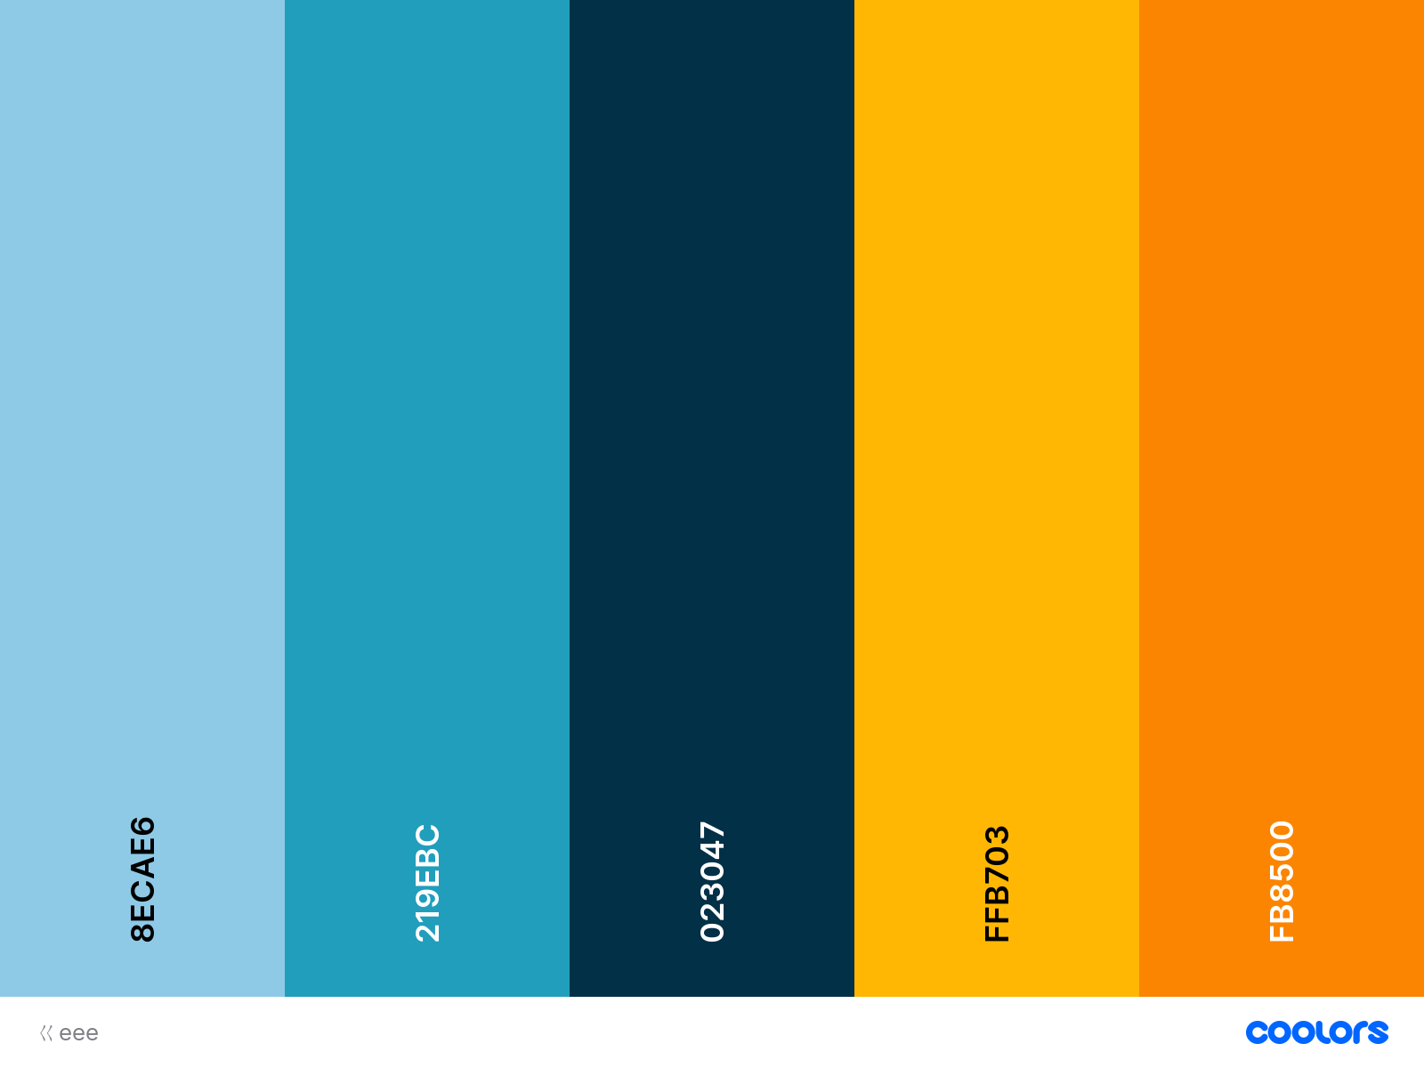
CMake Practice
Bing Han Lin

Slide 2
Contents
Why/What CMake
CMake Workflow
CMake Language
CMake Example
Improve CMakeLists.txt
Notes:
https://stackoverflow.com/questions/25789644/difference-between-using-makefile-and-cmake-to-compile-the-code

Slide 3
Why/What CMake
+ boo.cpp
Source code
CMakeLists.txt
CMake
+ boo.cpp
Source code
Generator of build systems
Makefile
Visual Studio
Xcode
Makefile
Visual Studio
Xcode
binaries
binaries
Notes:
https://stackoverflow.com/questions/25789644/difference-between-using-makefile-and-cmake-to-compile-the-code
https://cmake.org/cmake/help/v3.4/manual/cmake-buildsystem.7.html#runtime-output-artifacts

Slide 4
Family of Software Development Tools
CMake
Native Build Tools
CTest
CPack
Build System Generation
Build
Test
Package
Configure
Generate
https://cgold.readthedocs.io/en/latest/overview/cmake-can.html
Notes:
https://cgold.readthedocs.io/en/latest/overview/cmake-can.html

Slide 5
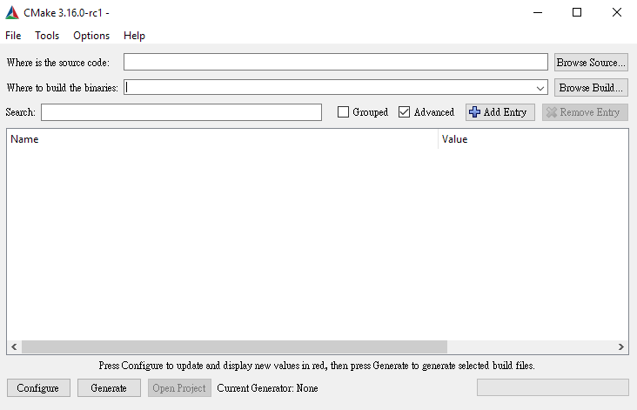
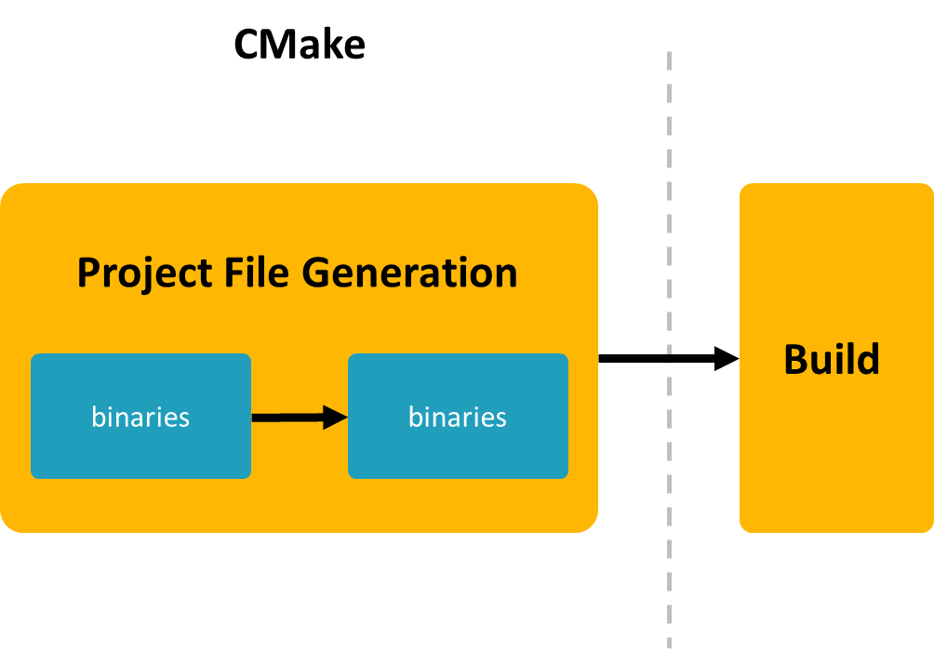
CMake Workflow
Generate a Project Build System:
> cmake …
Build a Project
> cmake --build …
Install a Project
> cmake --install …
Notes:
Cmake/help/latest/manual/cmake.1.html

Slide 6
How to write a
CMakeLists.txt?

Slide 7
CMake Language (1) Variables
set(FOO "x")
message(“FOO >> ${FOO} ")
set(CACHE_BOOL "ON" CACHE BOOL "a cache bool" )
message(“CACHE_BOOL >> ${CACHE_BOOL} ")
message("ENV_PATH >> $ENV{path}")
Normal
Variables are always string type.
Variable names are case-sensitive.
Access by ${YOUR_VAR} .
Always use “${YOUR_PATH}”.
Cache
Have global scope.
Can be set from the command line and Cmake GUI.
Have type and docstring (used in CMake GUI).
Environment
Have global scope.
Access by $ENV{VAR}.
Notes:
https://stackoverflow.com/questions/31037882/whats-the-cmake-syntax-to-set-and-use-variables

Slide 8

CMake Language (1) Variable Scope
Persistent Cache
Function Scope
Directory Scope
A variable set in a function is visible for the current function and any nested call within it.
function()
Function Scope
CMakeLists.txt
Directory Scope
Before processing the CMakeLists.txt file in the directory. Copy all variable bindings defined in the parent directory and initialize the new directory scope.
add_subdirectory()
Directory Scope
Directory Scope
Persistent Cache
CMakeLists.txt
CMakeLists.txt
Cache variables bindings are stored. Their
Icons made by Vitaly Gorbachev
Notes:
https://cliutils.gitlab.io/modern-cmake/chapters/basics/variables.html
https://preshing.com/20170522/learn-cmakes-scripting-language-in-15-minutes/

Slide 9
CMake Language (2) Targets & Target Properties
C
Create Target
add_executable(myApp main.cpp)
target_include_directories(myApp
PRIVATE
${PROJECT_SOURCE_DIR}/include
)
get_target_property(includeDirectory
myApp INCLUDE_DIRECTORIES
)
add_library ()
add_executable ()
Set Target Propertise
set_target_properties ()
target_link_directories ()
target_include_directories ()
Get Target Propertise
get_target_property ()
Notes:
https://zhuanlan.zhihu.com/p/76975231
https://ukabuer.me/blog/more-modern-cmake/
https://cmake.org/cmake/help/latest/manual/cmake-properties.7.html
https://cmake.org/cmake/help/latest/manual/cmake-commands.7.html
现代化的CMake是围绕 Target 和 Property 来定义的，并且竭力避免出现变量variable的定义。Variable横行是典型CMake2.8时期的风格。现代版的CMake更像是在遵循OOP的规则，通过target来约束link、compile等相关属性的作用域。如果把一个Target想象成一个对象（Object），会发现两者的组织方式非常相似：

Slide 10
CMake Language (3) Others
message(helloworld)
if(variable)
# variable is `ON`, `YES`, `TRUE`, `Y`, …
else()
# variable is `0`, `OFF`, `NO`, `FALSE`, …
endif()
function(fooFunc arg… )
# do something in function
endfunction()
math(EXPR var "1 + 2 * 3")
message
Control flow
Function
Macros
Math
…
Notes:
https://stackoverflow.com/questions/60317621/namespace-notation-in-cmakelists-txt

Slide 11
CMake Organization
Directories
script
module
Notes:
https://cmake.org/cmake/help/v3.7/manual/cmake-language.7.html

Slide 12
Let’s learn it by
Example.

Slide 13
CMake Example
01_hello-world
05_installing
Specify Build System Generator
Source & Binary Directory
CMAKE_INSTALL_PREFIX
install ()
02_include-header
06_using_subdirectory
-S <path-to-source> -B <path-to-build>
-G <generator-name>
target_include_directories()
add_subdirectory()
03_static-library 04_shared-library
07_cmake-package
Building Configuration Type
add_library(), target_link_libraries()
Notes:
https://www.slideshare.net/oliora/introduction-to-cmake-in-30-minutes
https://www.slideshare.net/DanielPfeifer1/cmake-48475415
https://myslide.cn/slides/12169
https://zh.wikibooks.org/wiki/CMake_%E5%85%A5%E9%96%80/%E8%BC%B8%E5%87%BA%E4%BD%8D%E7%BD%AE%E8%88%87%E5%AE%89%E8%A3%9D

Slide 14
Improve
CMakeLists.txt.

Slide 15
Use add_subdirectory( )
APP Organizer
CMakeLists.txt
Library 1
CMakeLists.txt
My Project
CMakeLists.txt
Library 2
CMakeLists.txt
Testing
CMakeLists.txt
Notes:
https://www.slideshare.net/oliora/introduction-to-cmake-in-30-minutes
https://www.slideshare.net/DanielPfeifer1/cmake-48475415
https://myslide.cn/slides/12169
https://zh.wikibooks.org/wiki/CMake_%E5%85%A5%E9%96%80/%E8%BC%B8%E5%87%BA%E4%BD%8D%E7%BD%AE%E8%88%87%E5%AE%89%E8%A3%9D

Slide 16
Handle Dependencies Around Targets
include_directories()
link_libraries()
target_include_directories()
target_link_libraries()
Notes:
https://www.slideshare.net/oliora/introduction-to-cmake-in-30-minutes
https://www.slideshare.net/DanielPfeifer1/cmake-48475415
https://myslide.cn/slides/12169
https://zh.wikibooks.org/wiki/CMake_%E5%85%A5%E9%96%80/%E8%BC%B8%E5%87%BA%E4%BD%8D%E7%BD%AE%E8%88%87%E5%AE%89%E8%A3%9D
https://code.egym.de/refactoring-a-cmake-build-system-9898c2030c3a
https://code.egym.de/how-to-use-modern-cmake-for-an-app-lib-project-3c2ee6018cde
http://www.stablecoder.ca/2019/03/15/sorting-you-dependency-graph.html

